Slide 1

粉末X光衍射图EM算法全谱线拟合
amorphous diffraction
报告人：曹 斌
导 师： 张统一

Slide 2
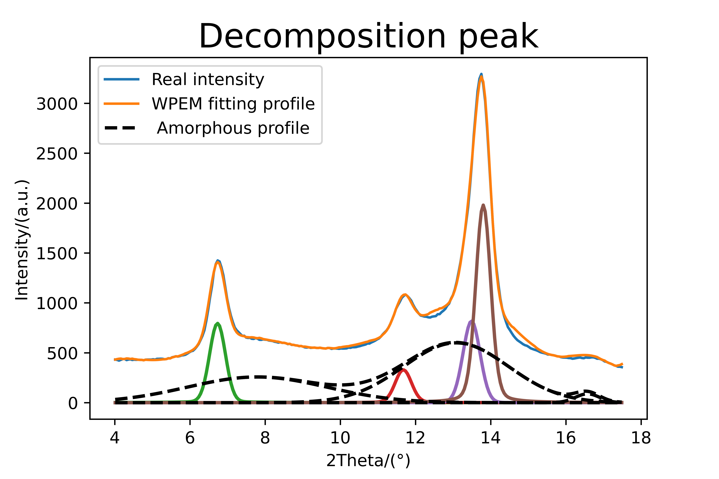

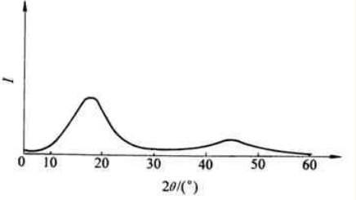
PB form I
Amorphous
halos
Rp=2.070, Rwp=3.218
relative bulk crystallinity ：39.799%
Amorphous pattern

Slide 3
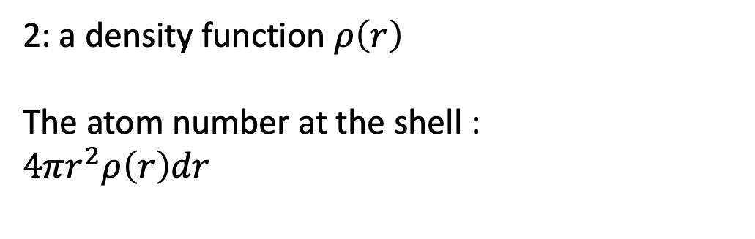
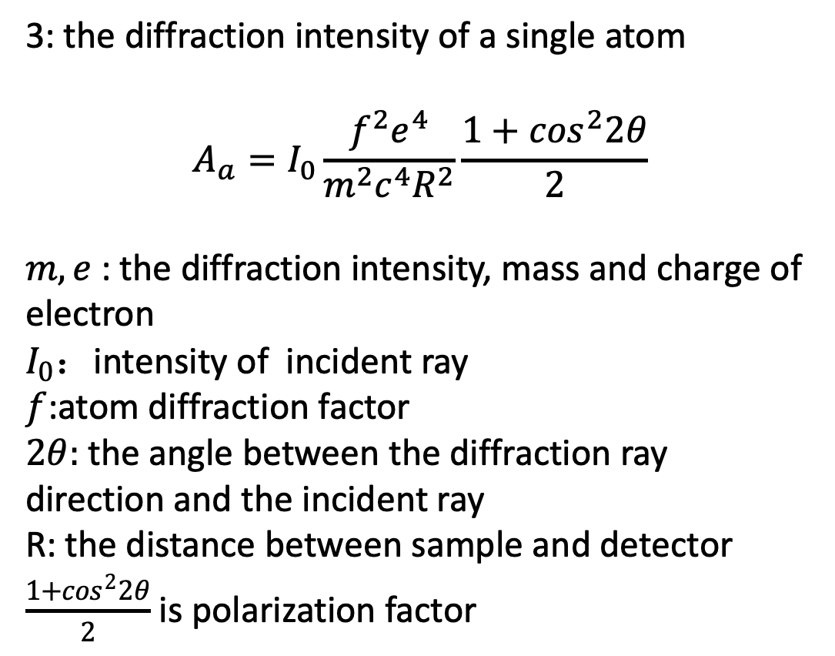
1: physical model
3: the diffraction intensity of a single atom
$$A_{a}=I_{0}\frac{f^{2}e^{4}}{m^{2}c^{4}R^{2}}\frac{1+\cos^{2}2θ}{2}$$
$m, e$ : the diffraction intensity, mass and charge of electron
$I_{0}$：intensity of incident ray
$f$:atom diffraction factor
$2θ:$the angle between the diffraction ray direction and the incident ray
R: the distance between sample and detector
$\frac{1+\cos^{2}2θ}{2}$ is polarization factor
dr
: an atom
A ball in 3-d
2: a density function $ρ\left(r\right)$
The atom number at the shell :
$4πr^{2}ρ\left(r\right)dr$

Slide 4




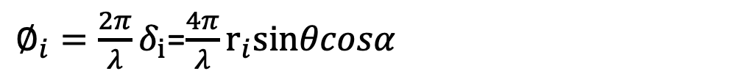




Assume there are Z+1 atom contained in the cluster
At a specific moment, we thave
$$r_{i}$$
displacement vector
$$\left|S\right|=\left|S_{o}\right|=1$$
$$S_{o}$$
$$S$$
$$S−S_{o}$$
$$r_{i}$$
$$S$$
$$S_{o}$$
coordinate origin
,one atom
Z atoms
Optical path distance:
$$δ_{i}=r_{i}∙\left(S−S_{o}\right)=2r_{i}sinθcosα$$
Phase distance:
${∅_{i}=\frac{2π}{λ}δ}_{i}$=$\frac{4π}{λ}r_{i}sinθcosα$
$$i :1,2,..,Z$$
$α$ : angle between vector $r_{i}$ and $(S−S_{o})$

Slide 5
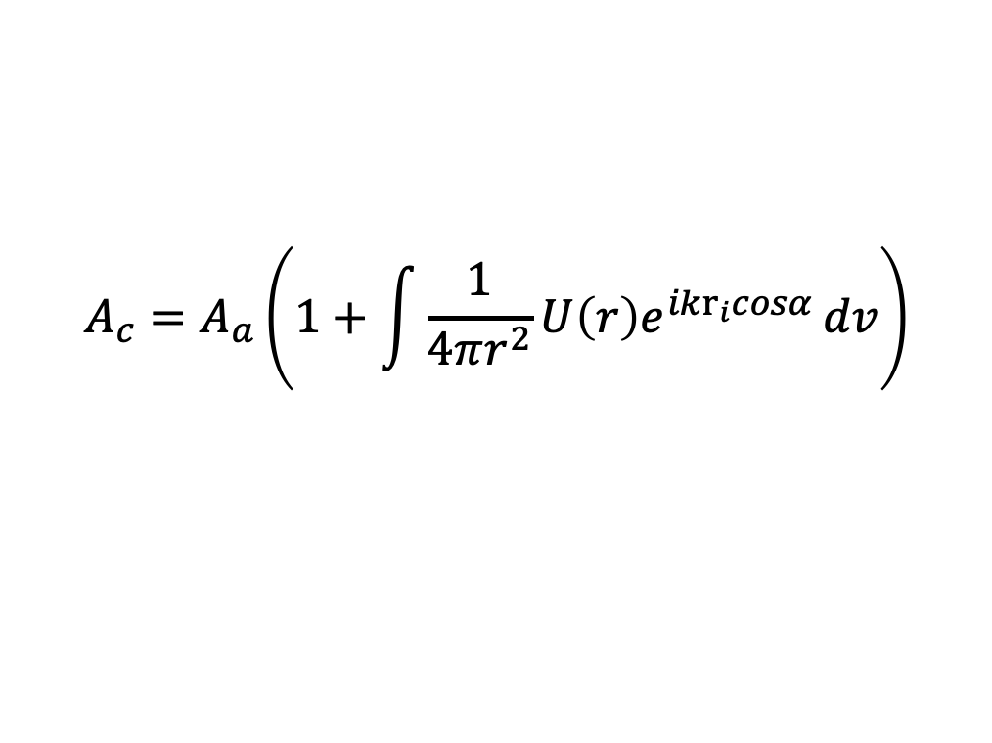
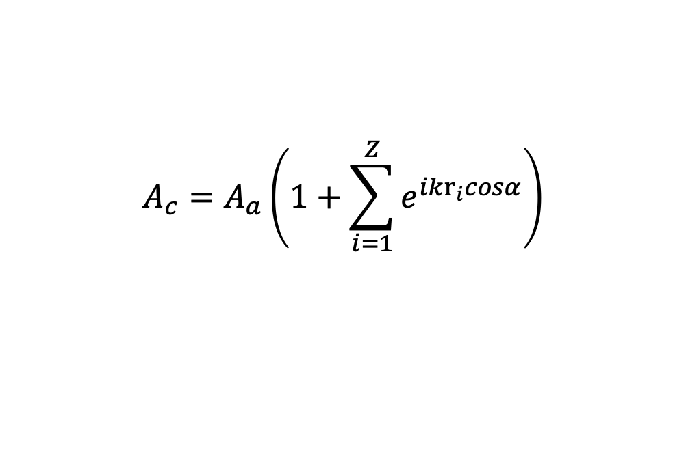

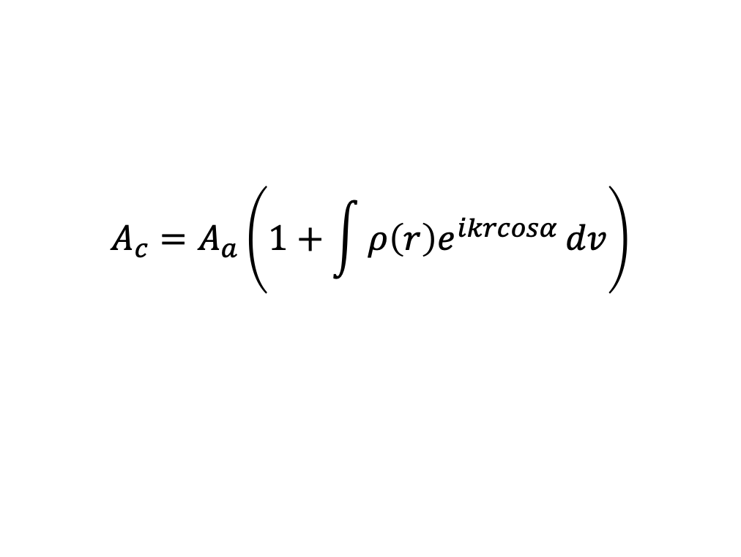

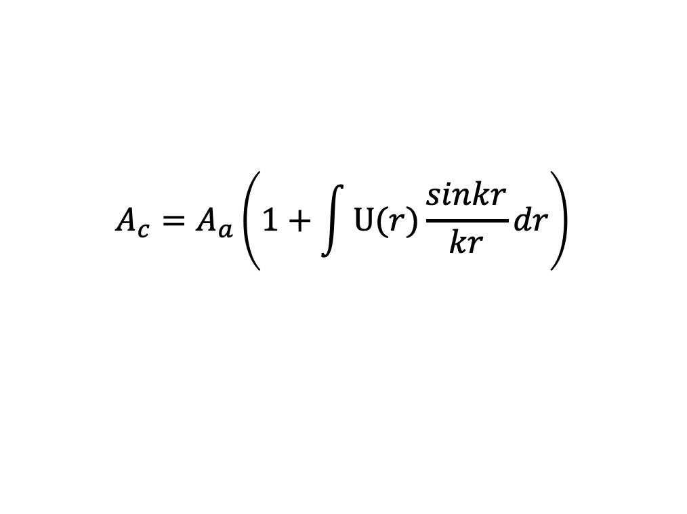
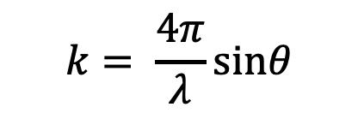
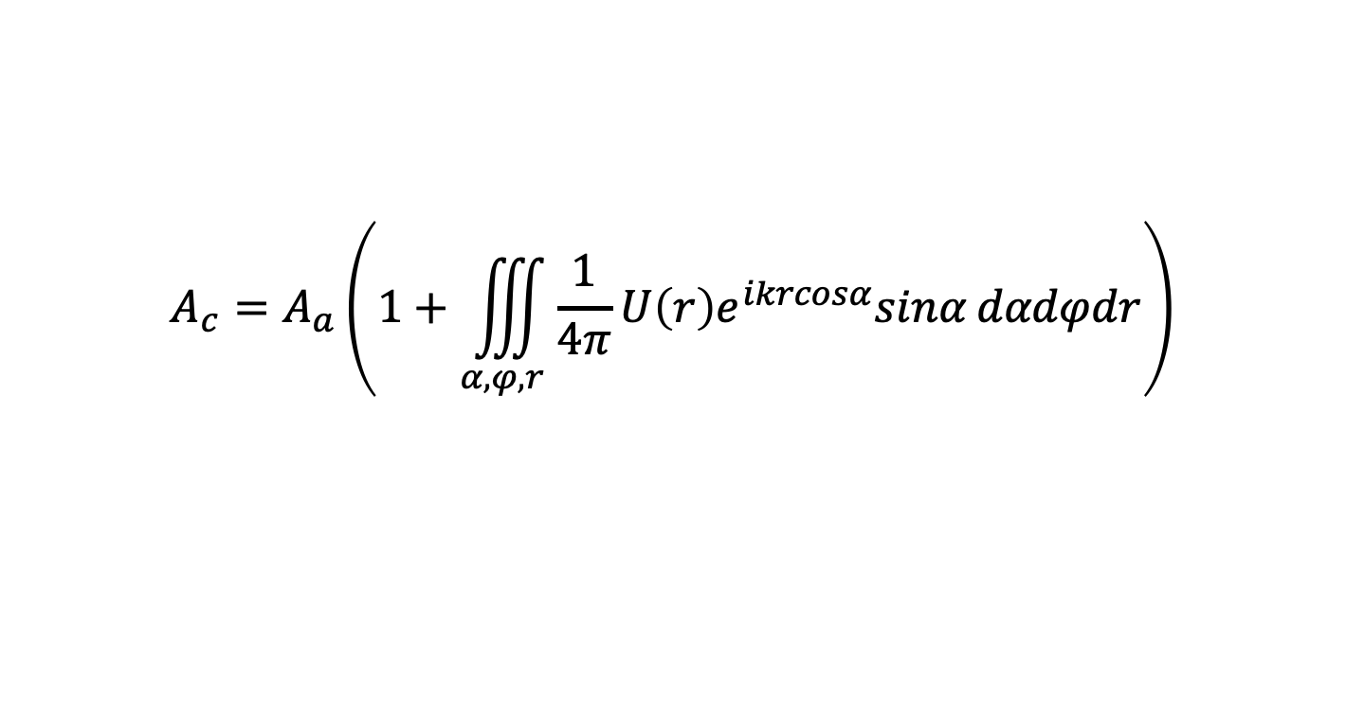
The total diffraction intensity of the cluster,
$$A_{c}=A_{a}\left(1+\sum_{i=1}^{Z}{e^{ikr_{i}cosα}}\right)$$
We define that : $U\left(r\right)=4πr^{2}ρ\left(r\right)$
$$A_{c}=A_{a}\left(1+\int{{\frac{1}{4πr^{2}}U\left(r\right)e}^{ikr_{i}cosα}}dv\right)$$
$$k= \frac{4π}{λ}sinθ$$
$$A_{c}=A_{a}\left(1+\iiint_{α,φ,r}{{\frac{1}{4π}U\left(r\right)e}^{ikrcosα}sinα}dαdφdr\right)$$
How to calculate atom’s number $Z$?
Assume that the atom is uniform distributed in sapce
We have
$$A_{c}=A_{a}\left(1+\int{U(r)\frac{sinkr}{kr}}dr\right)$$
$$A_{c}=A_{a}\left(1+\int{{ρ\left(r\right)e}^{ikrcosα}}dv\right)$$

Slide 6
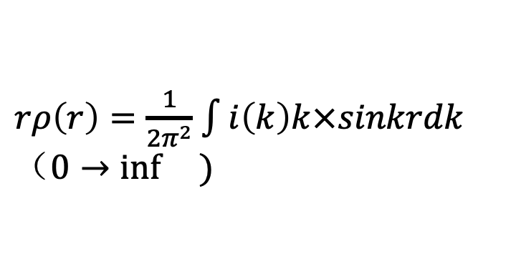

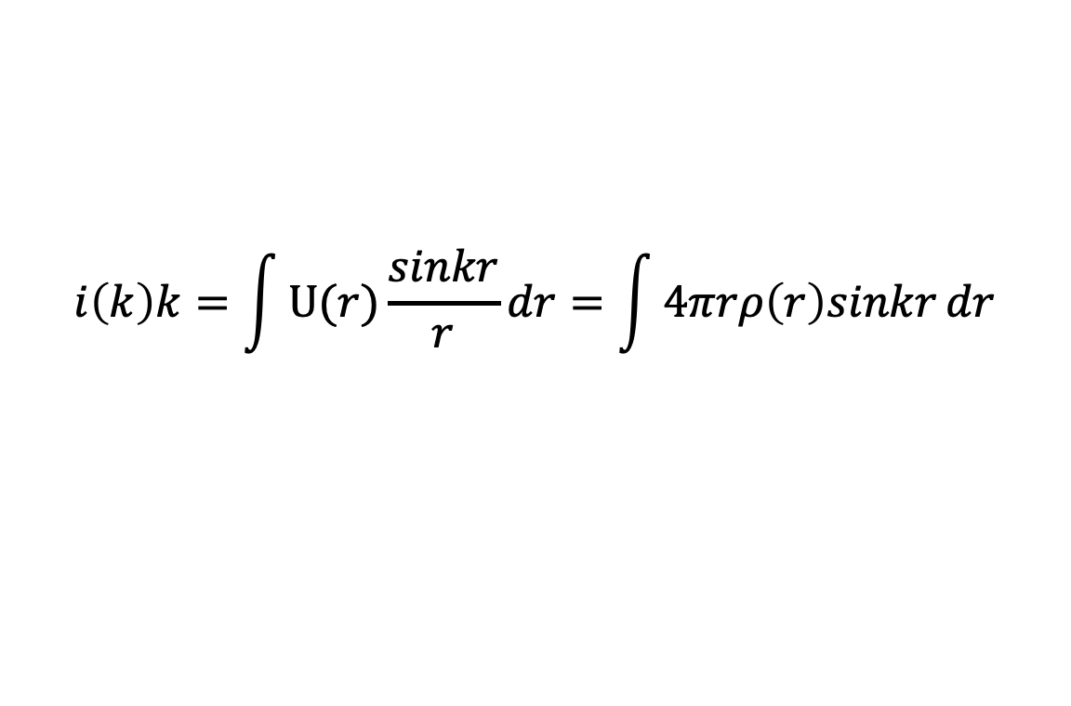
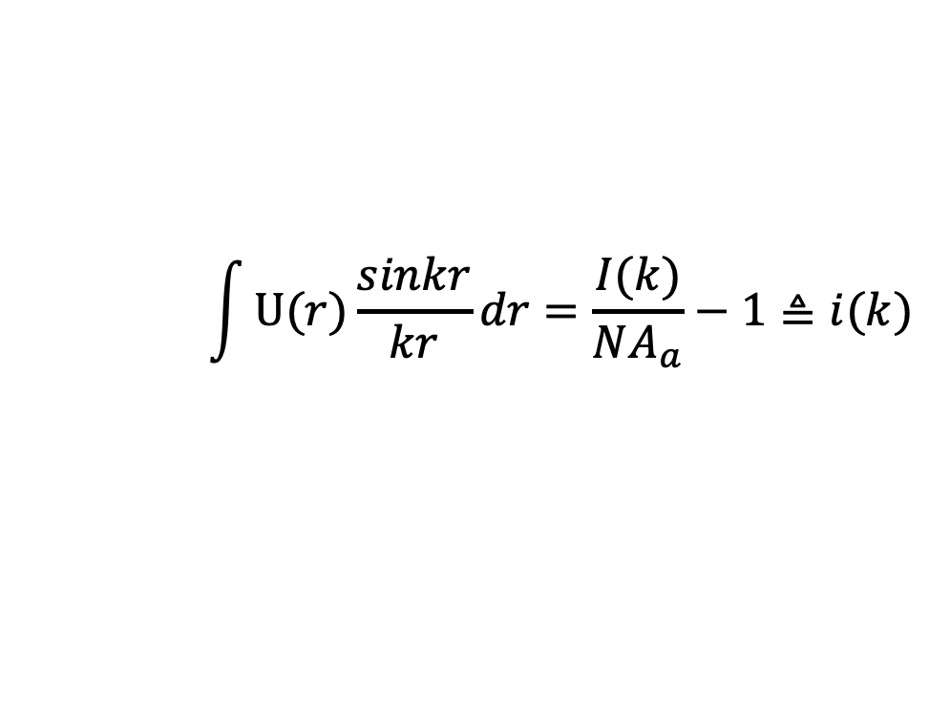
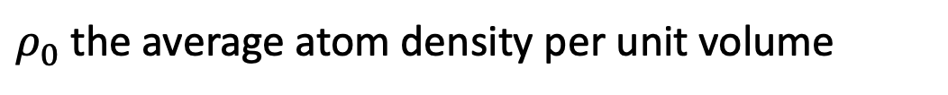
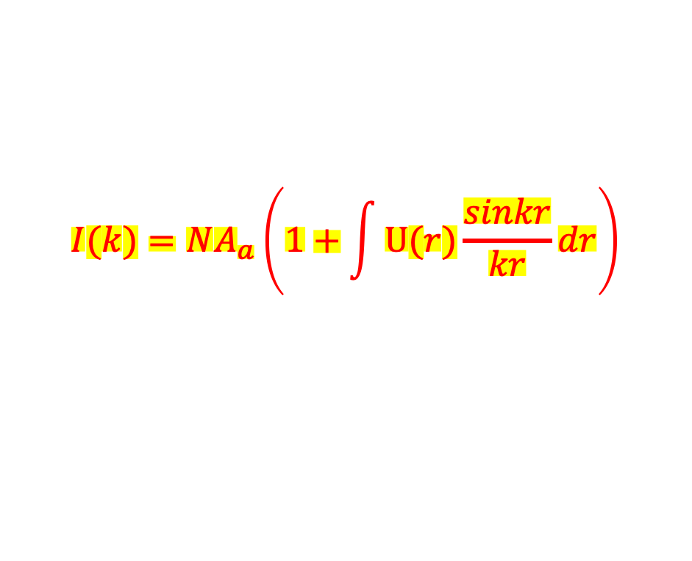
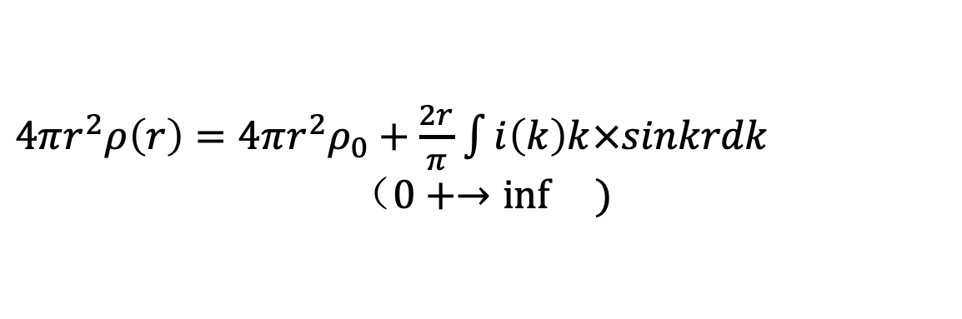
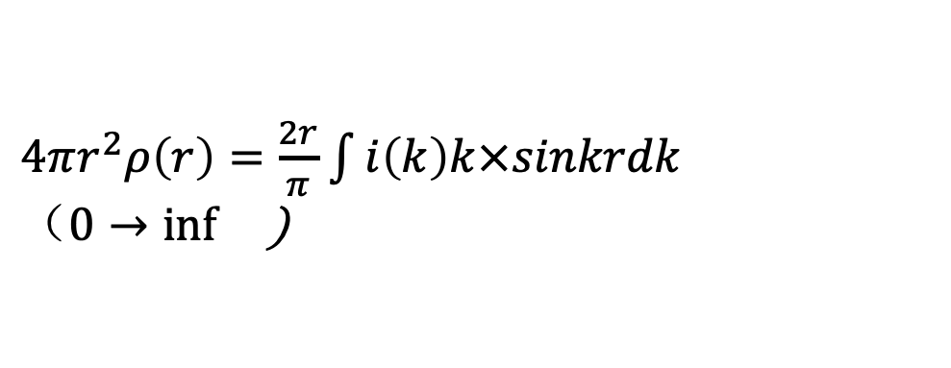
The total diffraction intensity of the sample,
$rρ\left(r\right)=\frac{1}{2π^{2}}$ $\int{i\left(k\right)k×sinkrdk （0→\inf{}) }$
$${I(k)=NA}_{c}$$
$N$ is the effective number of atoms in the sample
$$I(k)=NA_{a}\left(1+\int{U(r)\frac{sinkr}{kr}}dr\right)$$
$4πr^{2}ρ\left(r\right)=\frac{2r}{π}$ $\int{i\left(k\right)k×sinkrdk}$
$（0→\inf{}$)
$$\int{U(r)\frac{sinkr}{kr}}dr=\frac{I(k)}{NA_{a}}−1≜i(k)$$
$4πr^{2}ρ\left(r\right)=4πr^{2}ρ_{0}+\frac{2r}{π}$ $\int{i\left(k\right)k×sinkrdk}$
$$（0+→\inf{})$$
$$i\left(k\right)k=\int{U(r)\frac{sinkr}{r}}dr=\int{4πrρ\left(r\right)sinkr}dr$$
$ρ_{0}$ the average atom density per unit volume

Slide 7



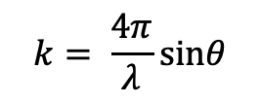










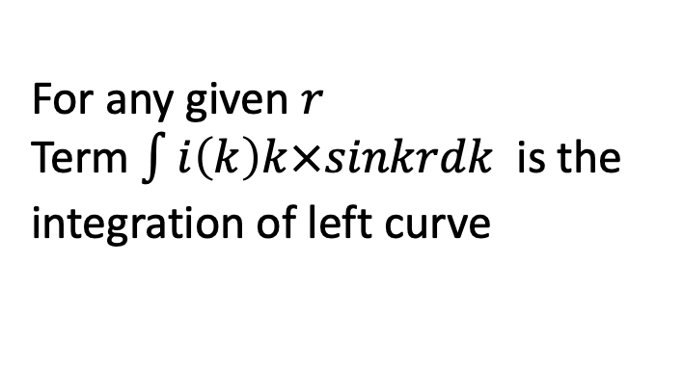
$$A_{a}=I_{0}\frac{e^{4}f^{2}}{m^{2}c^{4}R^{2}}\frac{1+\cos^{2}2θ}{2}$$
$$I(2θ)$$
$$k= \frac{4π}{λ}sinθ$$
$$I(k)$$
$$i\left(k\right)k$$
$$i\left(k\right)=\frac{I(k)}{NA_{a}}−1$$
$$2θ$$
$$k$$
$$k$$
For any given $r$
Term $\int{i\left(k\right)k×sinkrdk}$ is the integration of left curve
$$4πr^{2}ρ\left(r\right)$$
$$i\left(k\right)ksinkr$$
final pattern
$4πr^{2}ρ\left(r\right)=4πr^{2}ρ_{0}+\frac{2r}{π}$ $\int{i\left(k\right)k×sinkrdk}$
$$r$$
$$k$$

Slide 8
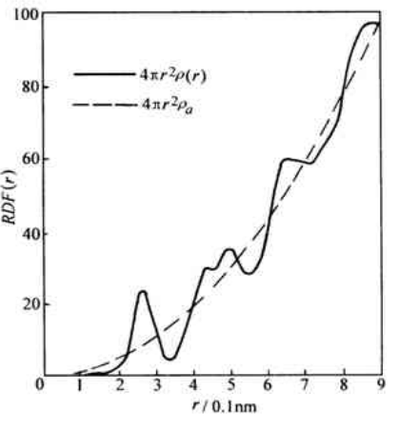
Integral area , A, represents coordination number
Peaks distance, d, represents average atomic distance
d
A

